Slide 2
TLS Weight Management Solution
A customisable and comprehensive weight management program that is designed to fit your personality, commitment level, goals and budget.

Slide 3
The TLS 4 Components
Low Glycaemic Impact Eating
Body Composition – Focus on Fat Loss
Supplements
Education
Notes:
Since TLS has 4 easy components, sharing it is easy!

Slide 4
What is TLS® Weight Management Solution?
TLS Weight Management Solution teaches about low-glycaemic impact eating and how to identify new favourite foods, creating new & healthy behaviours, and improving body composition to get our metabolism operating in high gear. Plus, with the help of specially formulated TLS supplements, everyone can find their fit in no time.

Slide 5
Why TLS® Weight Management Solution?
Teaches HOW to eat; not WHAT to eat
TLS is designed around the person’s goals & commitment level
Not just a weight management program; but a health program
Rebalances & improves metabolism with science-based supplementation
Focuses on FAT LOSS; not water or muscle loss
Notes:
Most weight loss programs tell you what to eat and how much to eat, but often fall short as a lifetime solution because they fail to address the REASON why you may be overeating, under exercising, and/or making unhealthy choices.
A weight loss plan only works if you stay with it. And as any successful dieter can tell you, it’s much easier to lose weight and firm up when the plan you choose fits your lifestyle and personality.
With TLS Weight Management Solution, no matter your personality, personal weight management goals or needs, it can work for you.
It’s a program designed around you, your goals, and your commitment level to achieving your personal health and fitness goals. It’s not about trying to fit in a box while saying, “just eat this and not that” or “do this, don’t do that.” It’s customised to you, the individual, and designed to keep you on track to achieve your personal weight loss goals and maintain a healthy lifestyle.

Slide 6
Why Low Glycaemic?
Low-glycaemic foods like clean proteins, high-fibre vegetables, fruits, beans and legumes, and quality fats help keep blood sugar levels stable.
When you have stable blood sugar levels, this will help keep your body balanced and help improve energy, sleep, how you react to stress and, most importantly, will help you burn fat instead of store it.
Low-glycaemic eating has also been shown to be superior for weight loss and weight management, cardiovascular health and more.

Slide 7
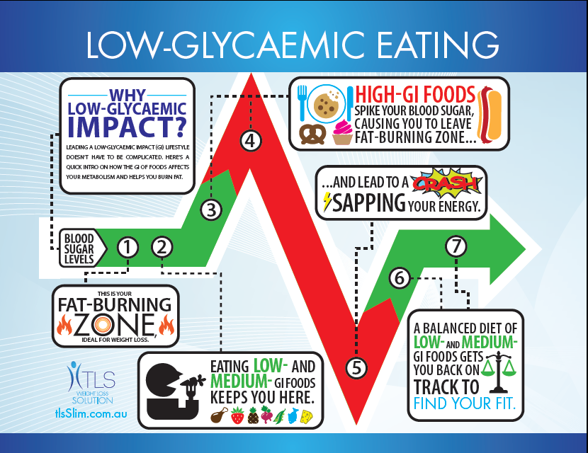

Slide 8
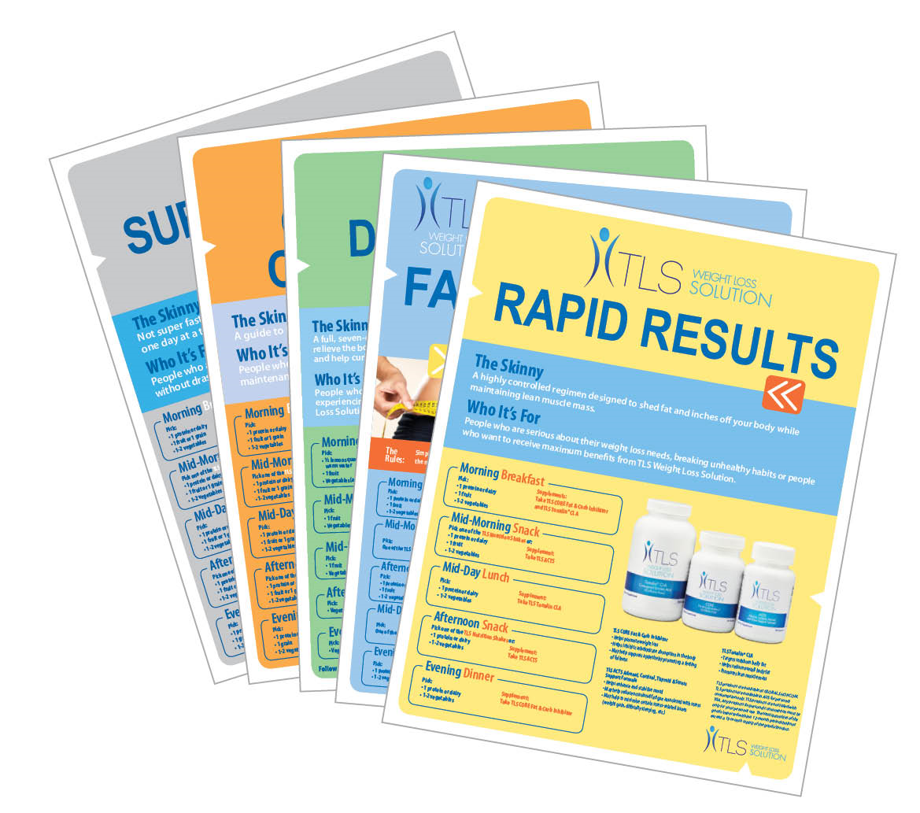
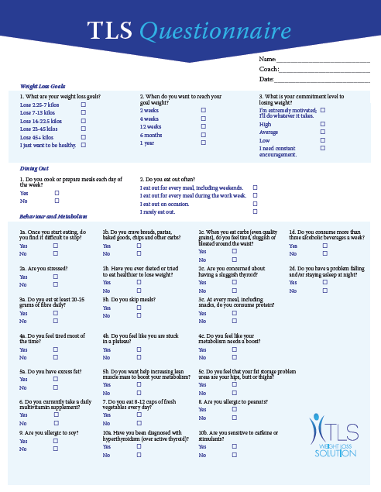
Menu Plans: Available on UnFranchise Downloads and tlsslim.com.au
Notes:
By completing the online or paper weight loss profile, your customer will be recommended one of 5 menu plans to help their find their fit. This will be based on their goals, commitment levels, and bodies personal needs. Talk about what each plan entails (summarise)

Slide 9
What to expect with TLS?
Notes:
Depending on their menu plan, each customer can expect to have results.

Slide 10
Introducing

Slide 11
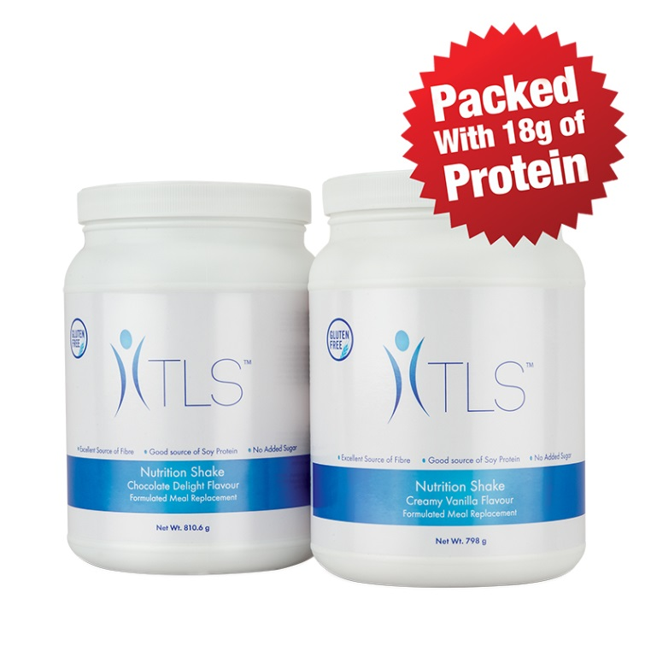
TLS Nutrition Shakes
Codes:
76391 Chocolate
76390 Vanilla
UC: $32.50
SR: $44.50
BV 10

Slide 12
Primary Benefits
A healthy meal replacement shake
Great tasting available in two flavours: Chocolate Delight & Creamy Vanilla
Includes 24 vitamins, minerals and essential nutrients , including 8 B-vitamins and also antioxidants vitamin C and E for protection from free radical damage
Easy to prepare - just add water or milk, blend and enjoy
Convenient, re-sealable canister for easy use and storage
Excellent source of fibre, contains 10-11 grams of dietary fibre
Feel full and stay satisfied: Packed with 18 grams of high quality soy protein to handle your hunger

Slide 13
Primary Benefits
When used in conjunction with regular exercise may contribute to weight loss or weight management
No colour added
Good source of calcium
Low in saturated fat
No added sugar
Gluten free

Slide 14
Key Ingredients
Protein (Soy)
Fibersol²
Vitamins
A, C, B1, B2, B5, B6, B12, D3, E, Calcium, Magnesium, Selenium, Zinc, Biotin
Notes:
Protein (SOY) Protein is an important component of every cell in the body. Your body uses protein to build and repair tissues, as well as produce enzymes, hormones, and other body chemicals. Protein is an important building block of bones, muscles, cartilage, skin, and blood. Unlike fat and carbohydrates, the body does not store protein, and therefore has no reservoir to draw on when it needs a new supply.
Clinical studies consistently show that high-protein diets increase satiety and decrease hunger compared with high-fat or high-carbohydrate diets. In addition, most of the studies reviewed showed that most people on high-protein diets displayed a 10 percent reduction in overall caloric intake.
Diets higher in protein and moderate in carbs—along with regular exercise—are often believed by experts to reduce blood fats. Protein also helps maintain lean tissue while burning fat for fuel and this happens without dieters being sidetracked with constant hunger. Researchers don't understand exactly how protein works to reduce appetite, but believe that it may be because protein causes the brain to receive lower levels of appetite-stimulating hormones.
Fibersol-2®
Fibersol- 2 is a digestion-resistant maltodextrin (soluble fibre) produced by a proprietary method of controlled enzymatic hydrolysis. Due to this proprietary method, Fiberol-2 cannot be metabolised or absorbed in the small intestine, but passes on into the large intestine. As it moves through the small intestine, this fibre slows the absorption of sugars from foods thereby helping the body to control its intake of sugar and therefore blood sugar levels. It also binds cholesterol so that it cannot be absorbed by the body, and this helps to improve the body’s overall cholesterol levels.
In the large intestine the maltodextrin in Fibersol-2 is slowly fermented by bacteria, thereby feeding the bacteria and improving the health of the colon. The fractions of the Fibersol -2 that cannot be fermented are excreted from the body which helps to improve bowel regularity and the removal of toxins from the body. Also, due to the way in which Fibersol-2 must be fermented, less acid and gas is produced than that caused by other soluble fibres.
Fibersol-2 helps to support bowel regularity and colon health, as well as healthy cholesterol and blood glucose levels.
This SHAKE Includes 24 vitamins, minerals and essential nutrients , including 8 B-vitamins and also antioxidants vitamin C and E for protection from free radical damage

Slide 15
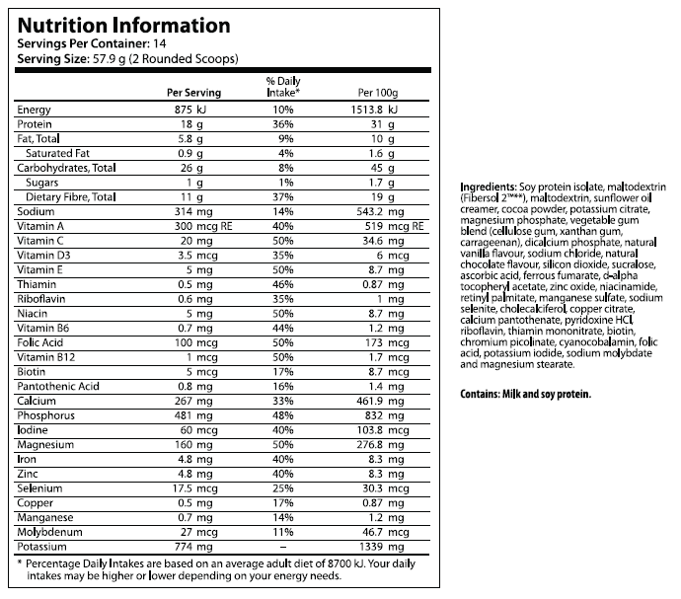
TLS Nutrition Shake Label

Slide 16
SALES SYSTEMS

Slide 17
TLS Sales Systems
A dynamic and powerful way to build your UnFranchise® Business!

Slide 18
Sharing TLS is easy!

Slide 19
TLS Sales System 1
Appropriate for UnFranchise owners who ‘major in TLS’ and/or prefer to use all the tools offered

Slide 20
STEP
1
Show or forward Introductory TLS Video to potential customer.
Search YouTube for “TLS Introduction”
www.youtube.com/watch?v=VT67BEes_MQ
Notes:
This Video is also available on your TLSSLIM.COM.AU portal! Once you log in, visit this link http://my.transitionslifestyle.com.au/resources/videos .

Slide 21
Our TLS Video Library
12 weeks of all new educational video’s are found on www.unfranchisetraining.com/

Slide 22
STEP
2
1) Review The TLS Flipchart (located on unfranchise.com.au under sales aids)
2) Make the person your preferred customer

Slide 23
STEP
3
Offer the Weight Management Profile Questionnaire (downloadable on unfranchise.com.au or tlsslim.com.au )

Slide 24
STEP
4
Review the TLS profile and review the suggested menu plan and begin
Review the TLS profile and recommend the 4-7 Day Detox Program then begin with the suggested menu plan

Slide 25
Note...
If the customer agrees to the 4-7 Day Detox Plan, provide them with the recommended products:
Isotonix® Multivitamin and Mineral,
Isotonix OPC-3
NutriClean Kit
TLS Core
Isotonix Isochrome
Be sure to have the products available!

Slide 26
The New TLS Coaching Support Program!

Slide 27
STEP
5
Introduce an optional TLS Coaching Support Program. While the recommended TLS Weight Loss Solution is a 12-weeks program, you can offer three options for personal support and education for your clients & customers. Each option will include the TLS Health Guide & Journal, weekly videos, and weekly support and review of the journal.
Option 1 – 4-weeks - $59.95
Option 2 – 6-weeks - $79.95
Option 3 – 12-weeks - $149.95

Slide 28
STEP
6
Ask for the order...
Will you be starting with the 4-7 day Detox or move right into their recommended plan? (Fat Shredder, Rapid Results, Sure and Steady, or Continued Commitment)
Tell them the cost and help them place their order on global.shop.com

Slide 29
STEP
7
Set the appointment or begin immediately:
Take measurements (chest, waist, hips, biceps, neck)
Measure the body composition (body fat)
Take the “before” picture (front, side, and back view in from fitting clothing)
Set the follow up and support schedule and assignments

Slide 30
Always have TLS Product on Hand
DO NOT BE WITHOUT PRODUCT!
THIS IS A LIFETIME EFFORT FOR OPTIMAL HEALTH.
Notes:
Note: To create the TLS Detox Kit, you will need to pull from your inventory: 1 TLS Core and 1 NutriClean 7-Day Cleansing System available from GLOBAL and 1 OPC-3 and 1 Multivitamin from SHOP.

Slide 31
TLS Sales System 2
An easy way for an UnFranchise owner to help someone lose weight without ‘majoring in TLS’

Slide 32
STEP
1
Forward the Introductory TLS Video to potential customer.
Search YouTube for “TLS Introduction”
https://www.youtube.com/watch?v=VT67BEes_MQ
Notes:
This Video is also available on your TLSSLIM.COM.AU portal! Once you log in, visit this link http://my.transitionslifestyle.com.au/resources/videos .

Slide 33
Our TLS Video Library
12 weeks of all new educational video’s are found on unfranchise.com.au under downloads

Slide 34
STEP
2
Review the TLS Flipchart, if appropriate

Slide 35
STEP
3
Offer the optional 4-7 day Detox Plan prior to starting the TLS Weight Management Solution Program.

Slide 36
STEP
4
Follow the easy flow for a comprehensive TLS Program

Slide 37
4-7 Day Detox
2 Week Fat Shredder
6 weeks Rapid Results
4 Weeks Sure & Steady
Continued Commitment

Slide 38
STEP
5
Offer the Optional Coaching Support Programs.

Slide 39
STEP
6
Ask for the order!

Slide 40
STEP
7
Begin TLS Weight Management Solution
Take the measurements (chest, waist, hips, biceps, neck)
Measure the body composition (body fat)
Take the “before” picture
Set the follow up and support schedule and assignments

Slide 41
TLS Sales System 3
Most simple sales system.

Slide 42
STEP
1
“The Triple 2 Rule”
Sell them 2 canisters of TLS Nutrition Shakes and enjoy 2 shakes per day and follow either of these 2 programs: Rapid Results or Sure and Steady Plan

Slide 43
Our TLS Video Library
They can also be sent the educational videos!

Slide 44
STEP
2
Send the interested customer a link to the TLS Shake product on your www.au.shop.com site.
Send the interested customer to your www.global.shop.com site to review the TLS products available on line from the United States.

Slide 45
TLS Nutrition Shakes
Codes:
76391 Chocolate
76390 Vanilla
UC: $32.50
SR: $44.50
BV 10

Slide 46
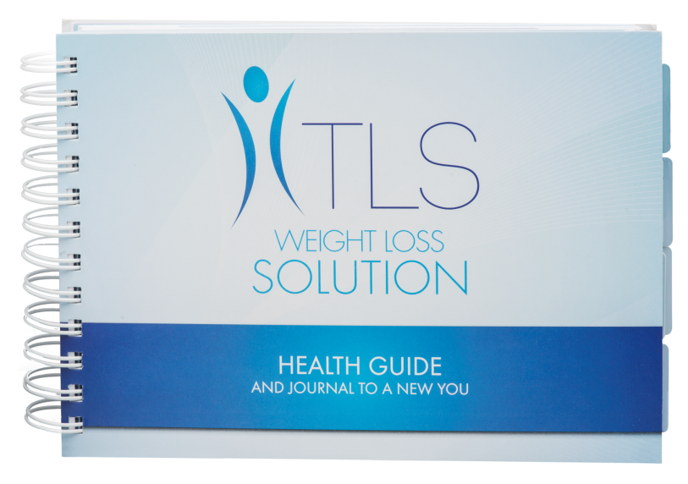
TLS Guide and Journal
Code: 76478
UC: $17.35
SR: $24.25

Slide 47
AUS TLS Business Building Challenge March 23, 2015 – June 23, 2015
Requirements located on your unfranchisetraining.com and back office
Move your business forward by helping people physically and financially
Don’t forget to purchase your tickets to Market Australia 2016 Annual Convention and/or 2015 Regional Convention in Singapore.

Slide 48
SALES SYSTEMS

